Slide 1
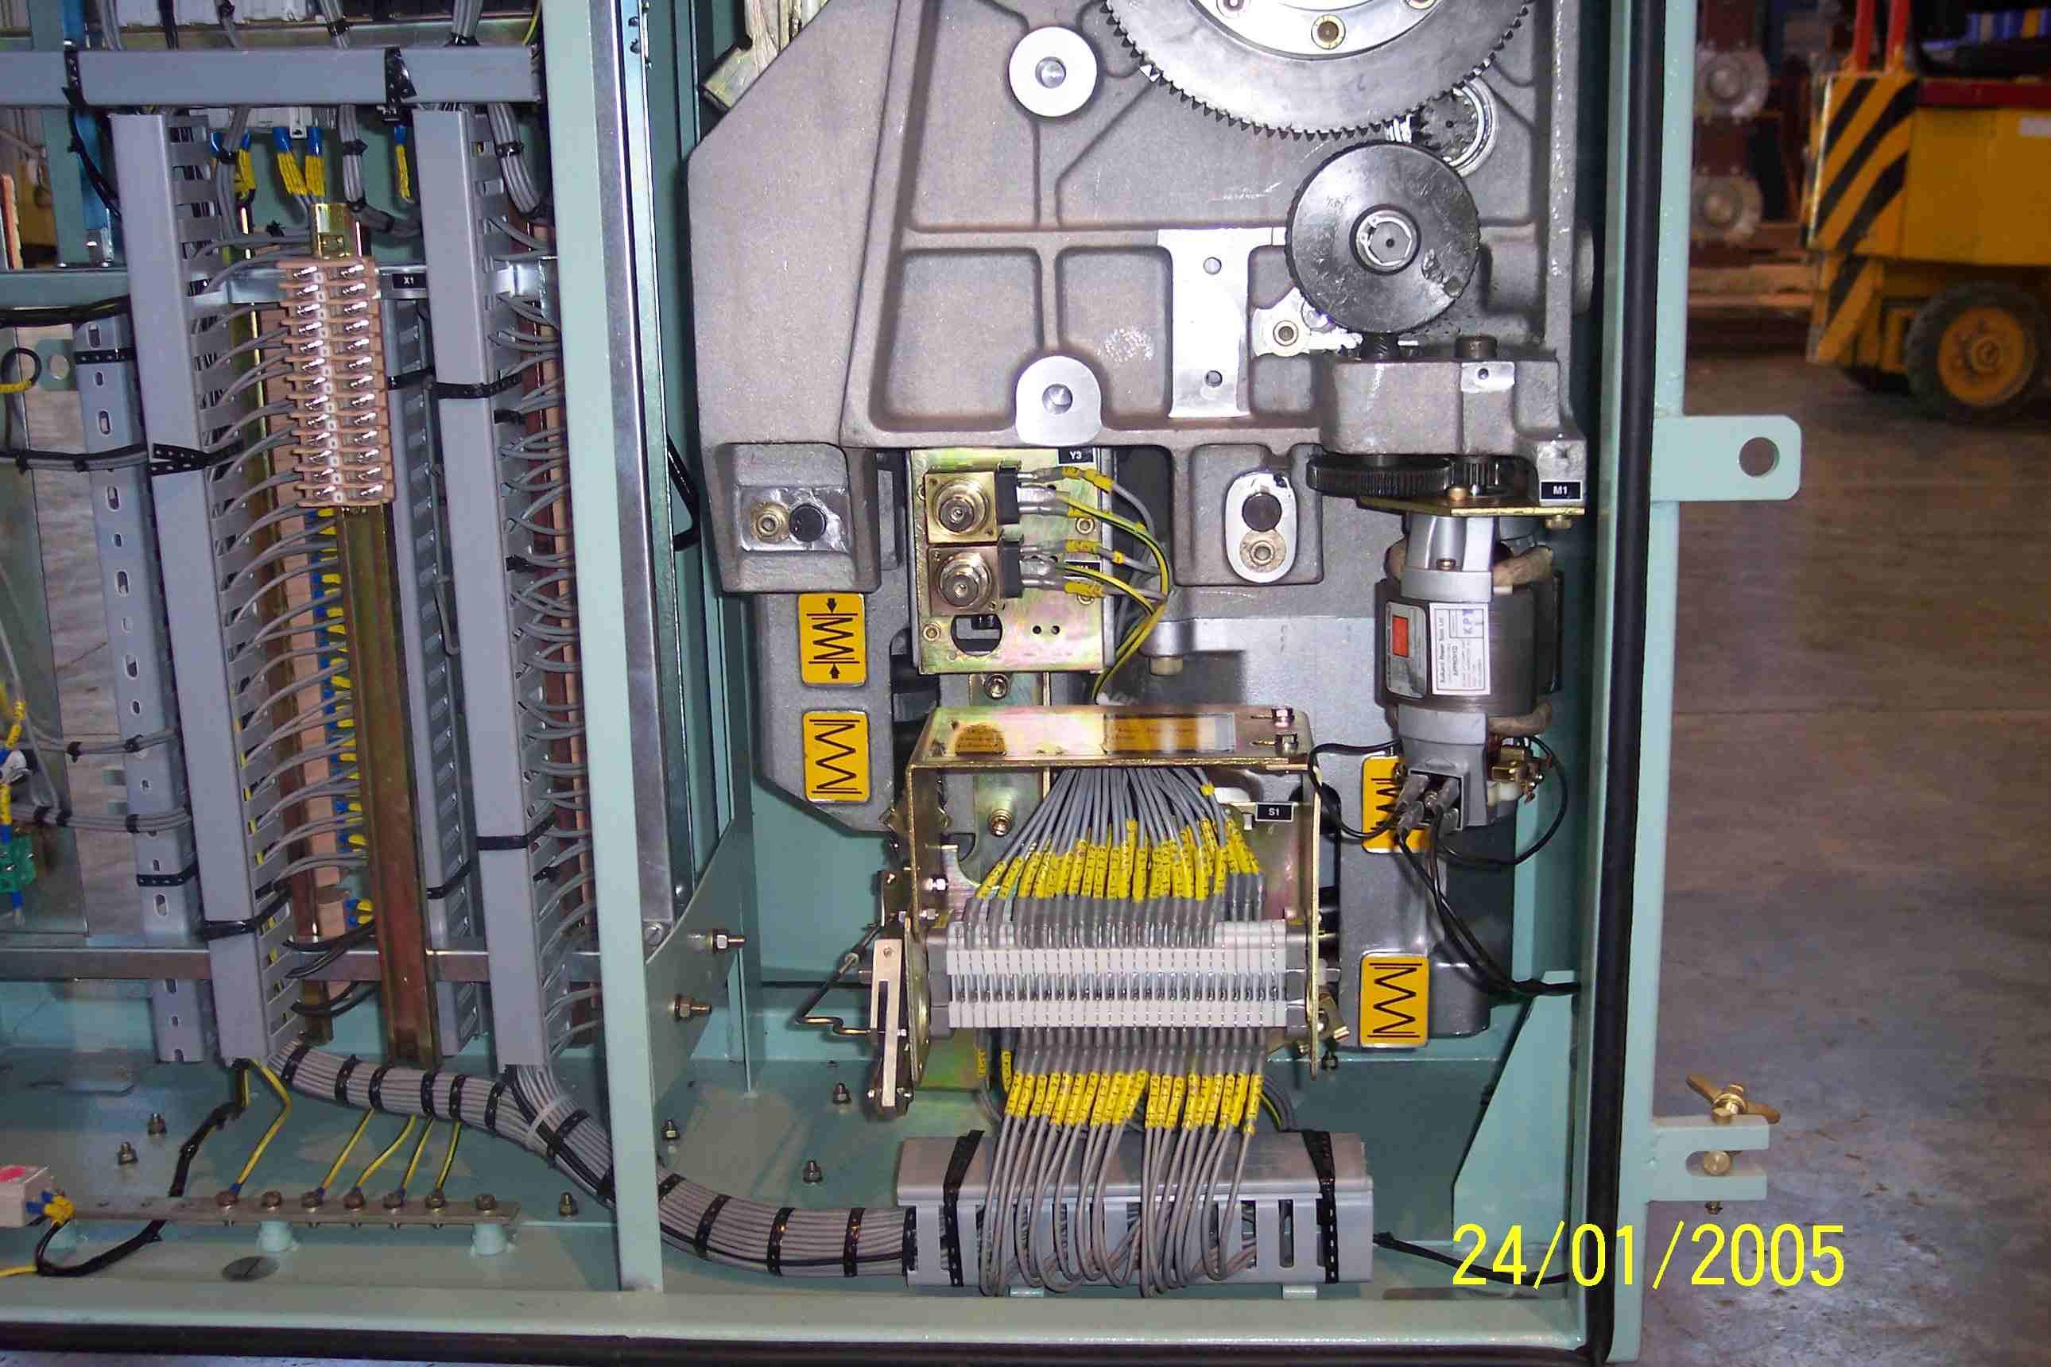
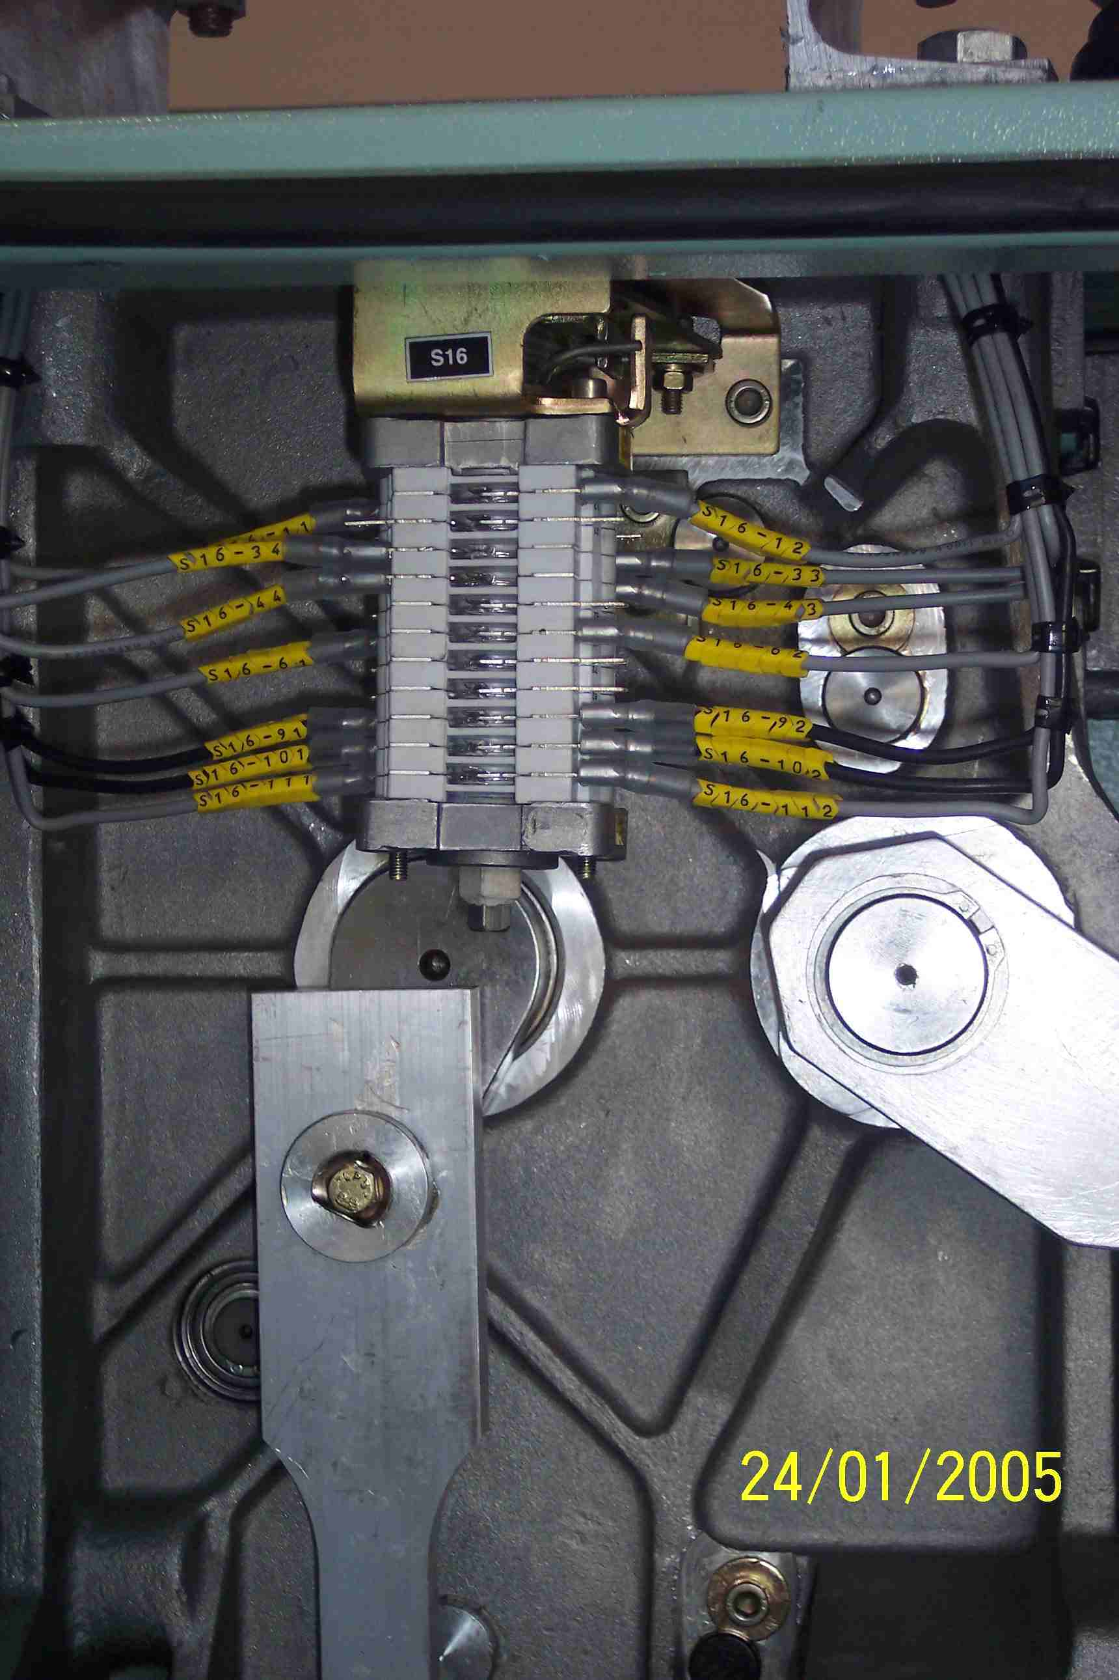
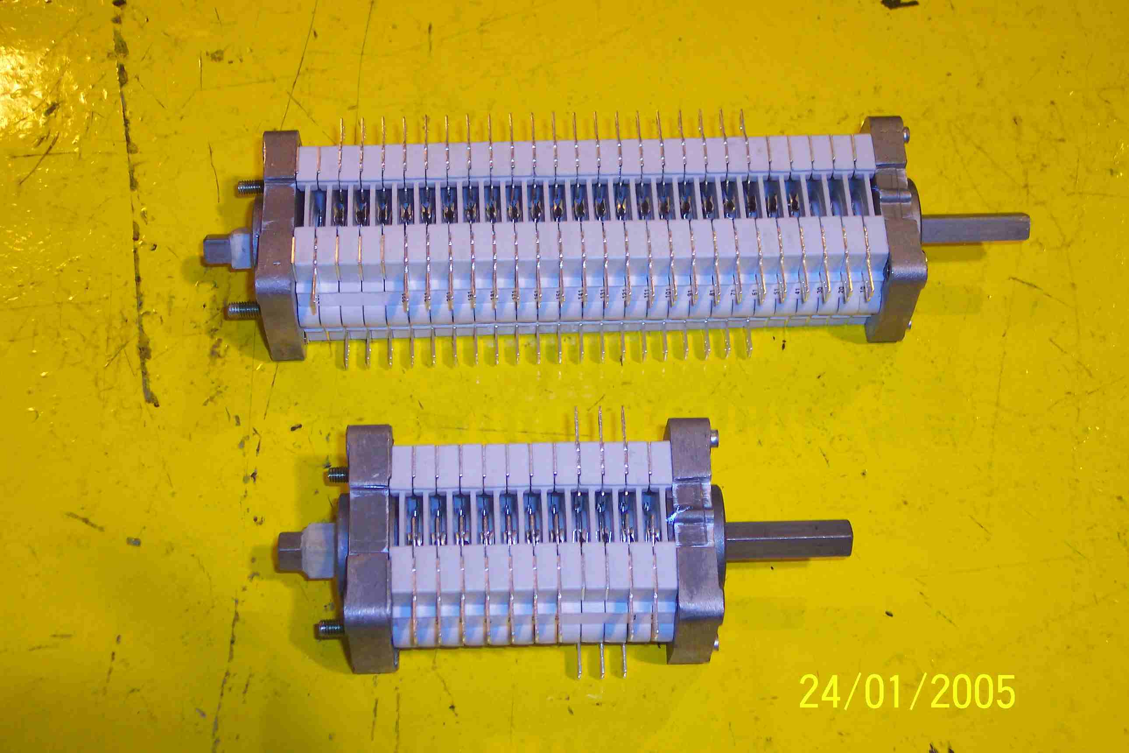
SIEMENS
HVCB SPARES
Aux.Sw Spring
Chg. Motor
S4799002933
Aux Switch CB
S4799001900
Same For 72.5KV, 145KV & 245KV HVCBs

